Slide 1
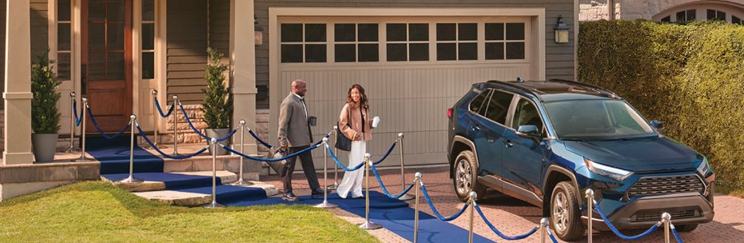



A True Partnership
May 2025
Home and Auto Group Insurance program
2023

Slide 2


The Personal is a subsidiary of Desjardins, one of the largest insurers in Canada
Desjardins Insurance is one of the largest Insurance groups in Canada with a portfolio of over 4.5 million policies, over $6.2 billion in premiums across Canada
Strong financial backing that supports new and innovative solutions for our clients
Our co-operative values allow us to focus on doing what's best for our members and clients while also supporting communities across Canada
The Personal Insurance is responsible for $1.9B in written premium
Notes:
Change format
Check number (4B),
Better way to say TPIC is a division of Desjardin (simplify with Desjardins group + TPIC)

Slide 3







Over 50 years!
Our group retention rate is dependably over 99%
Consistently rated Top Employer in many categories
The Personal Insurance proudly celebrated 50 years of providing Home and Auto Insurance benefits to over 650 different employer groups and associations in 2024
Notes:
Over 739 – AIF
TPIC closing ratio 31.7%

Slide 4



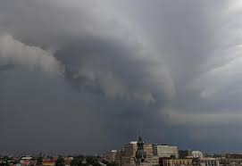
What’s happening in the industry?
Factors Impacting Home and Auto Insurance Premiums
Profitability, Reforms and Rising rates
Rising auto thefts, injury claims costs and government rate freezes are putting profitability pressures on insurers.
AI is helping speed up processes but also creating more opportunities for fraud.
Economic and political uncertainty
Inflation pressures, economic uncertainties, rising costs of parts and materials are all putting upwards pressure on claims costs and often making claims last longer
Flood, Fires, Hail, Oh My!
Insured damage due to severe weather is increasing
In 2024, there was $8.5 billion in insured damage – smashing the record of $6.2 billion set in 2016
Between 2001-2010, Insurers averaged $675m/year in weather related losses

Slide 5
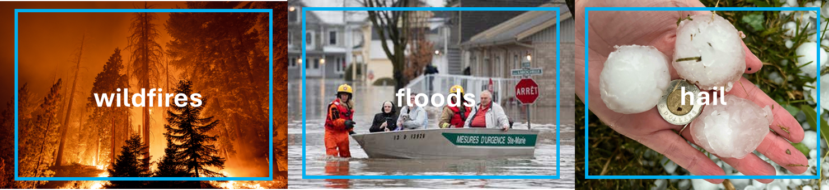
Natural Catastrophes – Summer of 2024
2024 ranks as the highest losses the industry has experienced from natural catastrophes and severe weather events
The summer of 2024 had 4 severe weather events across the country resulting in nearly 44,000 claims for DGIG clients
Date | Event | Industry Losses | Total DGIG Claims
August 10 | Quebec Flooding | $2.5 Billion | 26,605
August 5 | Calgary Hail Storm | $2.8 Billion | 19,755
July 16 | Ontario Flooding | $940 Million | 3,590
July 22 | Jasper Wildfires | $880 Million | 45

Slide 6

Impacts of Rising Costs, Claims & Tariffs
Observations over the past 5 years:
In extreme weather, (i.e. Calgary’s record hailstorm last year), both cars and homes are equally susceptible to damage.
Auto theft has increased significantly in Ontario, Quebec and Alberta.
From 2019-2024, vehicle prices have increased from a low of 45.1% in Alberta to a high of 85.5% in Quebec.
Electric vehicles are costlier to repair and there are more of them on the roads.
Increases in parts, maintenance and repair costs for private passenger vehicles, which can contain up to tens of thousands of parts.
Despite lowering fatality rates vehicle safety features have led to increased claims costs.

Slide 7








Why work with us?
Easy to implement
plan
At no cost to your organization
Specialized
advice
Exceptional
service
A dedicated
account manager
Exclusive group
rates
Comprehensive
coverage
Digital and innovative solutions

Slide 8
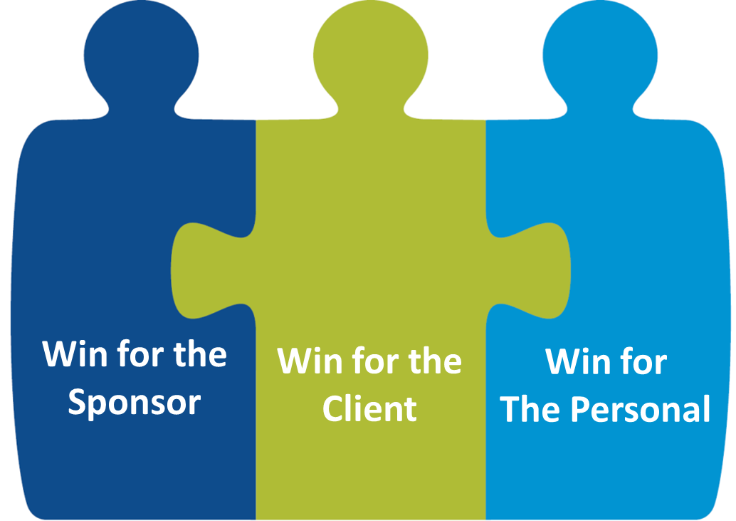
Win-Win-Win Philosophy
Win For your organization
Win For your employees/members
Win For The Personal
Turn-key insurance plan
No cost to your organization
Easy to implement plan
Dedicated account manager
Omnichannel marketing approach tailored to your needs and priorities
Source of revenue to support your initiatives
Exclusive group rates
Comprehensive insurance protection
Personalized advice, offers and support
Proactive claim assistance
Strong digital experience and innovative technologies
Industry-leading customer service
A meaningful long-term partnership with your organization
Recognition as a leader amongst providers for HR professionals
Addition of a valuable, high profile partner

Slide 9
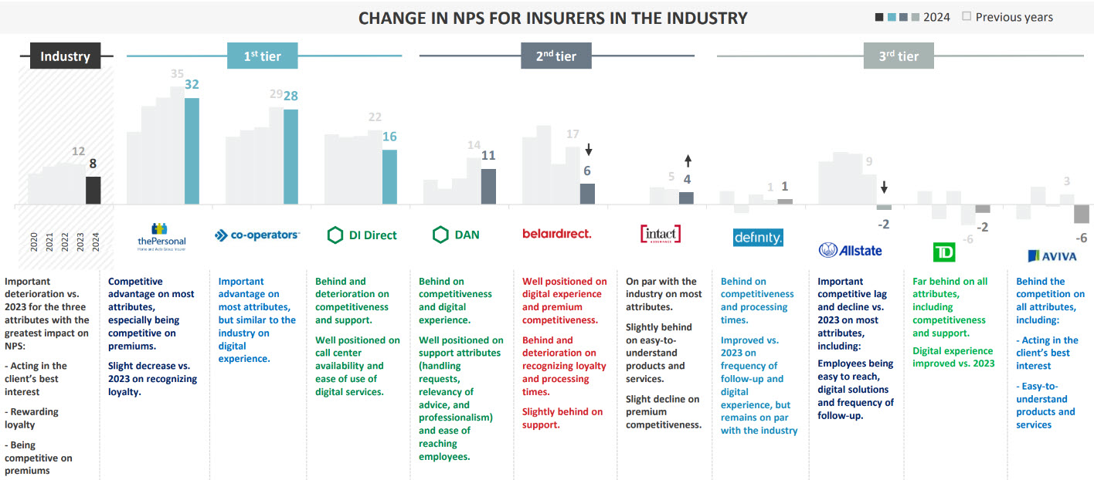
Net Promoter System
Comparing The Personal with the industry
Net Promoter Score – Auto and Property Insurance Industry
The Personal leads the industry and maintains the top tier
Data as of December 2024

Slide 10













Our Competitive Products
Auto
Home
Recreational vehicles
Pet
Travel
10

Slide 11
Additional Savings & Benefits
Auto Insurance Savings
Good Driving Record Savings: Save more if you have a clean driving record with no chargeable accidents or serious convictions
Home Insurance Savings
Multi-Line Savings: Save up to 35% on your home insurance when you bundle it with auto insurance
Claims-Free Offer: Save up to 20% if you have been claims-free for several years
Water Damage Prevention System Savings: Save up to 10% if you have systems like automatic water valve shut-off, leak detectors, or a pneumatic backflow system.
Alarm System Savings: Save up to 10% if you have a centrally-monitored fire and burglar alarm system installed in your home
Additional Benefits
Identity Theft Assistance: Get free identity theft assistance when you insure your home with The Personal.
Ajusto® Program: Sign up for Ajusto and get a 10% enrolment discount on your auto insurance premium for the first 6 months
Pet Insurance For Cats and Dogs: Get your cat or dog the care they need and help avoid unexpected vet bills
Recreational Vehicle Insurance: Exclusive rates on motorcycles, boats and other RVs
Travel Insurance: Take advantage of The Personal Travel Insurance Program
Radar™: If there’s a risk of severe weather that could damage your home and belongings, you’ll get an alert
Multi-Vehicle Discount: Save more when you insure two or more cars with The Personal
Conviction Free/Zero Violations: Save more if you've had no traffic violations in the last 3 years
Notes:
Projected budget of $173 million

Slide 12

Great partners make great programs
A worry-free experience for your Association and its members
A group insurance expert, we protect your members’ wealth and the strength of your association.
We listen to our customers and learn from them to continually improve our offer and service.
Our experience, products and service are why 97% of our partners are satisfied with The Personal
Win Win Win philosophy
12

Slide 13

We want to be your partner!
Contact us anytime, we make the process easy and we are always happy to help.
Roger L Demas, B.Comm
Manager, Business Development
403-585-8146
roger.demas@thepersonal.com
David Rizk, MBA CIM
Director, Business Development
438-451-9614
david.rizk@dgag.ca

Slide 14
Thank you !
Thank you!

